Slide 1
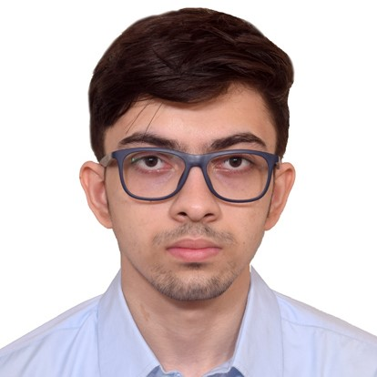

Abhilash Mukherjee
Analyst/Software Engineer
Bachelor of Technology,
Electrical Engineering : 2018-2022
iTransform L&D Left Shift Batch
Skills
Mumbai
C# | Basics, OOPS, Exception Handling, Arrays, Collection and Generics.
.NET Framework | ADO .NET, ASP .NET with MVC5 and Web API, Entity Framework.
Ado.net | Basics Architecture
Database | SQL
Tools | GIT
UI Technology | HTML5 ,CSS & Angular
Add On Skills | Communication Skills, Team Management
abhilash.mukherjee@capgemini.com
+91 9831102301
A4
Full Stack Developer
Understanding of RDMS concepts using SQL Server.
Practical understanding of C# and SQL concepts using Visual Studio and SQL Server
Hands on experience in developing applications using .NET Framework, ADO.NET Core
Understanding of HTML5 , CSS and Angular Cli
Experience in creating documentation with Swagger and Postman
Completed case study on Online Hotel Management System which is a Web based System which will automate the major operations of the hotel. This system will be able to handle many services to take care of all customers in a quick manner. As a solution to the large amount of file handling happening at the hotel, this software will be used to overcome those drawbacks.
Technologies used:
ANGULAR
ASP .NET CORE
Microsoft SQL Server
Video Link : Click
GitHub Link

